Slide 1

The 2023 Financial Crisis
Tom Mack, MBA, A+, Net+
Presenter

Slide 2
Fair Use Notice
The images and videos used in this presentation belong to their respective copyright holders.
These images and videos used in this presentation are used for education, criticism, comment, teaching, and research constituting a Fair Use Exemption under §107 of the United States Copyright Act of 1976.
“Fair Use” is defined as a use permitted by copyright statute that might otherwise be considered infringement.

Slide 3
Disclaimer
The information contained in this presentation is educational material only and is NOT intended to be considered investment advice. Mr. Mack is NOT a registered investment, legal, or tax advisor, or a broker/dealer of securities. All investment/financial opinions expressed by Mr. Mack are from personal research and experience and is intended as educational material only. Although best efforts are made to ensure that all the information contained herein is accurate and up to date, occasionally unintended errors and misprints may occur.

Slide 4
18 U.S. Code §241 - Conspiracy Against Rights
If two or more persons conspire to injure, oppress, threaten, or intimidate any person in any State, Territory, Commonwealth, Possession, or District in the free exercise or enjoyment of any right or privilege secured to him by the Constitution or laws of the United States, or because of his having so exercised the same; or
If two or more persons go in disguise on the highway, or on the premises of another, with intent to prevent or hinder his free exercise or enjoyment of any right or privilege so secured—
They shall be fined under this title or imprisoned not more than ten years, or both; and if death results from the acts committed in violation of this section or if such acts include kidnapping or an attempt to kidnap, aggravated sexual abuse or an attempt to commit aggravated sexual abuse, or an attempt to kill, they shall be fined under this title or imprisoned for any term of years or for life, or both, or may be sentenced to death.
(June 25, 1948, Ch. 645, 62 Stat. 696; Pub. L. 90–284, title I, § 103(a), Apr. 11, 1968, 82 Stat. 75; Pub. L. 100–690, title VII, § 7018(a), (b)(1), Nov. 18, 1988, 102 Stat. 4396; Pub. L. 103–322, title VI, § 60006(a), title XXXII, §§ 320103(a), 320201(a), title XXXIII, § 330016(1)(L), Sept. 13, 1994, 108 Stat. 1970, 2109, 2113, 2147; Pub. L. 104–294, title VI, §§ 604(b)(14)(A), 607(a), Oct. 11, 1996, 110 Stat. 3507, 3511.)

Slide 5
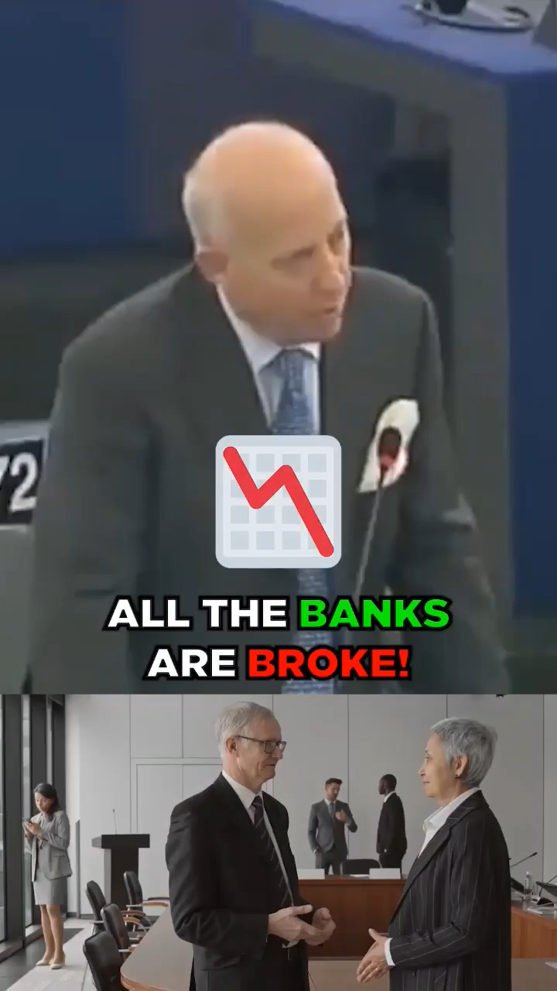
From The floor Of the European Parliament

Slide 6
How Did We Get in This Mess?
As with most things, we need to study the history of banking.
Once we study the history of banking, we can understand how things came into being and analyze how each element.
Then, we need to apply the scriptures to each element and use them to both determine the validity and to understand what the result will be.

Slide 7
Scriptures from Revelation
And the great city was divided into three parts, and the cities of the nations fell: and great Babylon came in remembrance before YHWH, to give unto her the cup of the wine of the fierceness of his wrath. (Revelation 16:19)
Standing afar off for the fear of her torment, saying, Alas, alas, that great city Babylon, that mighty city! for in one hour is thy judgment come. (Revelation 18:10)

Slide 8
What’s Babylon Role in All of This?
Babylon is the blueprint for the Antichrist religious system. It has three components:
A religious system based upon Ba’al which when translated from Hebrew to English, literally means “Lord.” Isaiah 56:11 when properly translated from Hebrew calls the elohim Gawd a false elohim. The KJV improperly translates Gimel-Daleth as “troop.”
An economic system based upon fiat currencies. Money is only worth what people believe it is worth.
A political system designed to enhance the wealthy and is based on false legal system that encourages corruption.

Slide 9
Falling Into Idolatry?
When Israel and then Judah fell into apostasy, they went from following YHWH to worshipping Baal.
Most people did not know the difference because the worship terminology is very similar.
So, Manasseh made Judah and the inhabitants of Jerusalem to err, and to do worse than the heathen, whom YHWH had destroyed before the children of Israel. (II Chronicles 33:9)
Considering Manasseh followed Hezekiah, one of the most righteous kings of Judah and was followed by Josiah, another notable righteous king, one must wonder why the people stood for it?

Slide 10
Falling Into Idolatry?
And YHWH spake by his servants the prophets, saying,
Because Manasseh king of Judah hath done these abominations, and hath done wickedly above all that the Amorites did, which were before him, and hath made Judah also to sin with his idols:
Therefore, thus saith YHWH Elohim of Israel, Behold, I am bringing such evil upon Jerusalem and Judah, that whosoever heareth of it, both his ears shall tingle.
And I will stretch over Jerusalem the line of Samaria, and the plummet of the house of Ahab: and I will wipe Jerusalem as a man wipeth a dish, wiping it, and turning it upside down.
And I will forsake the remnant of mine inheritance, and deliver them into the hand of their enemies; and they shall become a prey and a spoil to all their enemies;
Because they have done that which was evil in my sight and have provoked me to anger, since the day their fathers came forth out of Egypt, even unto this day. (II Kings 21:10-15)

Slide 11
Falling Into Idolatry?
Because Judah choose to fall into the Idolatry of Egypt, YHWH let them fall into the hands of Nebuchadnezzar, the king of Babylon.
He choose Babylon because they practiced the same kind of idolatry as did Egypt.
After Nebuchadnezzar conquered Judah, he proceeded east to conquer Egypt. Many of the artifacts of Egypt were brought to Babylon, just as much of the temple was also brought to Babylon.
Babylon would eventually assimilate much of Egypt into their own culture. Because of that, Babylon became the new situs of the false world religion.

Slide 12
Nebuchadnezzar’s Dream
The Bible warns us about Babylon and its extended culture in Daniel 2 when King Nebuchadnezzar has a dream that when he awakens, he cannot remember.
The astrologers, magicians, sorcerers, and Chaldeans are consulted, but when they cannot recount the dream, the king threatens to kill them all.
Finally, Daniel makes a name for himself by revealing the dream and then interpreting it.

Slide 13

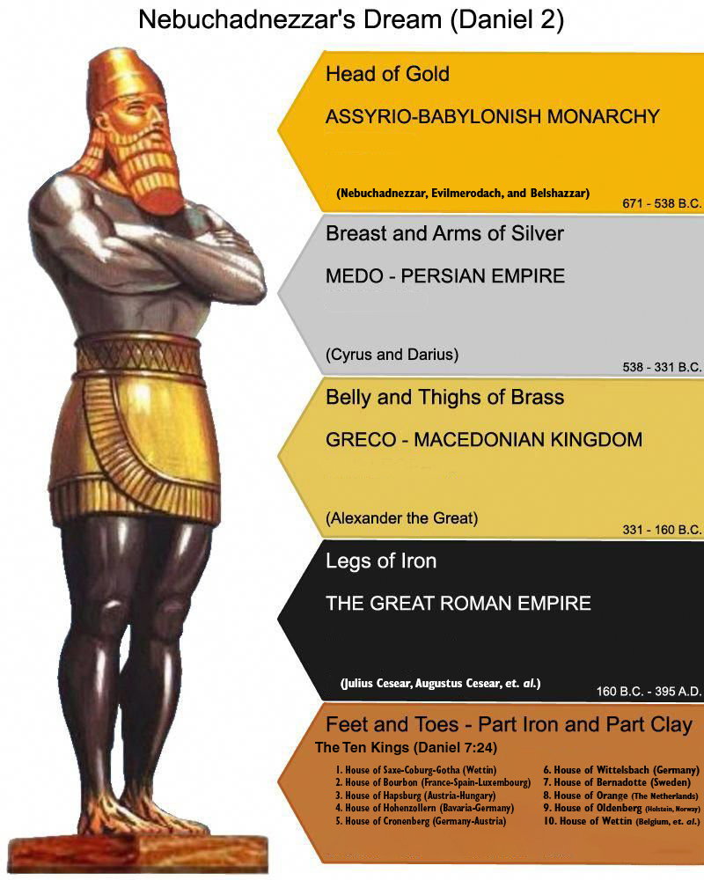
Nebuchadnezzar’s Dream
Daniel was able to identify the five major western civilizations from the king’s dream.
It is interesting that each of these civilizations had a banking system.
Babylon serves as the foundation for the modern banking system. We will refer to this image throughout this presentation.

Slide 14
Banking in Ancient History
Banking got its start in Western Civilization in Early Babylon.
People making trips would store their precious metals in “banks” and receive cuneiform tablets (paper money would come much later, papyrus was expensive and did not last long) representing their holdings in that bank.
The bank would take a percentage of the stored metal as payment for their services.
Later, these tablets were replaced by coins minted by the banks.

Slide 15
Banking in Ancient History
Seeing it was such a good business, national governments took over the minting of coins in Israel, Babylon, Persia, and Greece.
Rome also minted it own coins, but as Roman History continued, the amount of the metal in the coins decreased. Some historians would suggest this situation as the first case of monetary inflation.

Slide 16
Politics in the Middle Ages
After Rome fell, in the West, the Merovingian kings took over Western and Northern Europe. Their most famous king was Clovis I (509-511) because he converted to Christianity. They were famed for their long hair and because they allegedly “rose from the sea.”
It didn’t stop the Papacy from trying to create a political kingdom that it could control. The first attempt was just called “the Roman Empire” in A.D. 800 when Pope Leo III crowned Carolingian King Charlamagne I.

Slide 17
Banking in the Middle Ages
After Charlamagne and his sons finished their rule, the kingdom (like Alexander the Great before them) was broken into four parts:
Kingdom of Germany
Kingdom of Italy
Kingdom of Bohemia (Czech Republic)
Kingdom of Burgundy (Southeast France)
The “Golden Bull” of 1356 officially created the “Holy Roman Empire.” It became a de facto constitution for the Empire.

Slide 18

Banking in the Middle Ages
The First Crusade (1096-1099) saw the Knights’ Templar loot Jerusalem (AKA Solomon’s Treasure).
When the Knights’ Templar’s fortunes of war began to wane late in the 12th century, they started bringing that wealth back to Venice in what it now Italy.
The infusion of this money led to the creation of the Banco del Giro in Venice in 1157. They issued “letters of credit” which became a kind of money. This was also the first time we saw banks lend money to customers.
The bank collapsed after the Kingdom of Venice (a medieval city-state) got into a foolish war with the Byzantine Empire in 1171 and lost badly. The Doge Vitale II Michael was assassinated shortly thereafter.

Slide 19
Banking in the Middle Ages
The Venetians got their revenge with The Fourth Crusade (1202-1204), which saw the Crusaders manipulated into attacking Constantinople to loot its wealth and transfer it initially, to Venice to pay back the “loans” and the rest was repatriated to the German, French, and English states.
The re-establishment of banks in Venice and Florence would not occur until the early 14th century when several “private” banks began doing business.

Slide 20
Transfer of Wealth to Europe
The Royal Families of Europe found themselves held hostage to the bankers of Venice and the Pope of Rome.
So, he carried me away in the spirit into the wilderness: and I saw a woman sit upon a scarlet-colored beast, full of names of blasphemy, having seven heads and ten horns.
And the woman was arrayed in purple and scarlet color, and decked with gold and precious stones and pearls, having a golden cup in her hand full of abominations and filthiness of her fornication:
And upon her forehead was a name written, MYSTERY, BABYLON THE GREAT, THE MOTHER OF HARLOTS AND ABOMINATIONS OF THE EARTH. (Revelation 17:3-5)

Slide 21
Transfer of Wealth to Europe
When a Royal Family wanted to go to war, they had to arrange financing for their upcoming war with the bankers of Venice.
At first, part of the financing process was getting permission from the Papacy to approve:
the financing for their proposed war, and
the war itself.

Slide 22
Transfer of Wealth to Europe
In time, the Venice bankers created branches in Frankfurt, Paris, and London.
When politics in southern Europe began to destabilize in the late 18th century, they centralized their operations in their branches in Central and Northern Europe.
We saw the Rothchild Family take over much of the banking activity in Central and Western Europe. However, they wanted full-control over the monetary system of the World.

Slide 23
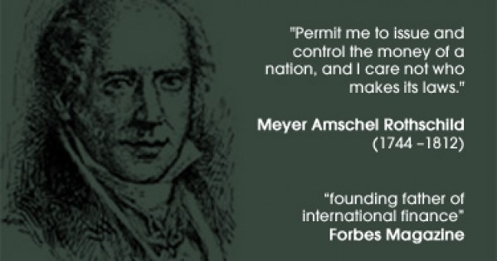
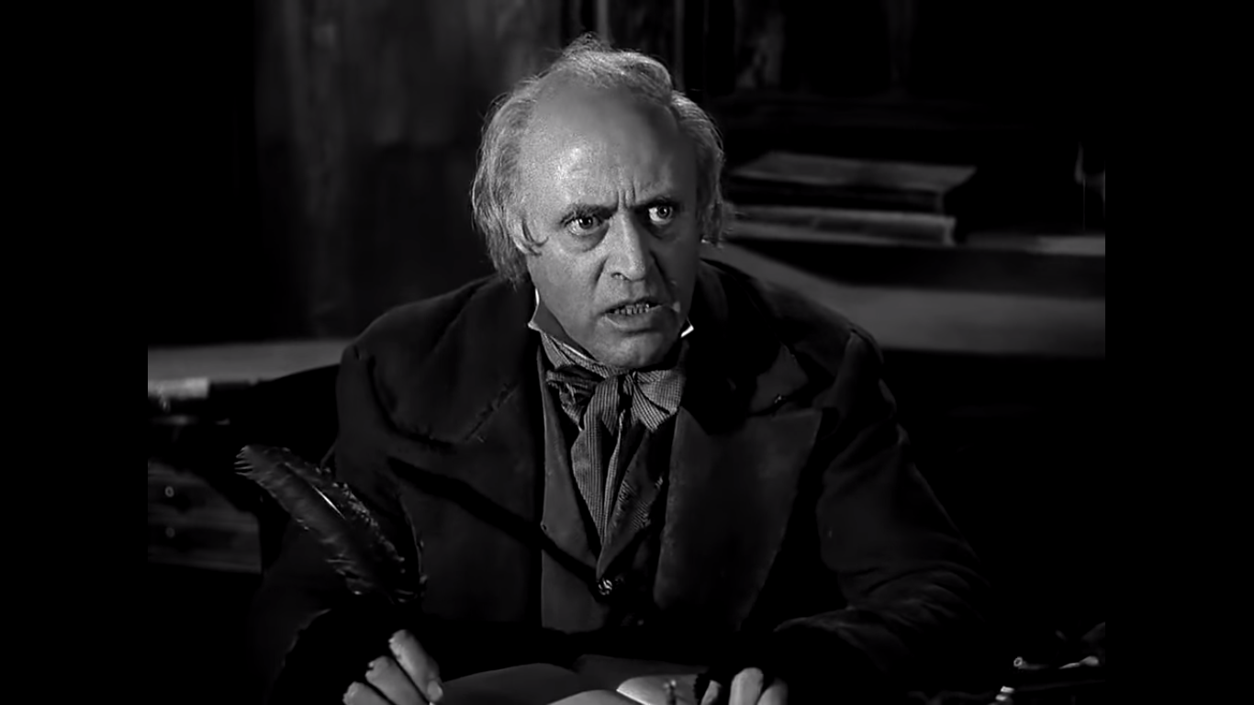
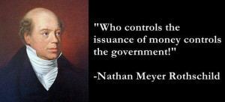
Alistair Sim as Scrooge in 1951

Slide 24
Transfer of Wealth to Europe
In 1806, the Holy Roman Empire was “dissolved,” and the Congress of Vienna completed a complex agreement.
After Napoleon I’s loss in the Battle of Waterloo, the Rothchild Family took over the banking activities of Central and Western Europe.
They created “central” banks in England, France, Belgium, The Netherlands, and in the 39 German states (Prussia, Bavaria, and the city-states) of the former Holy Roman Empire.

Slide 25
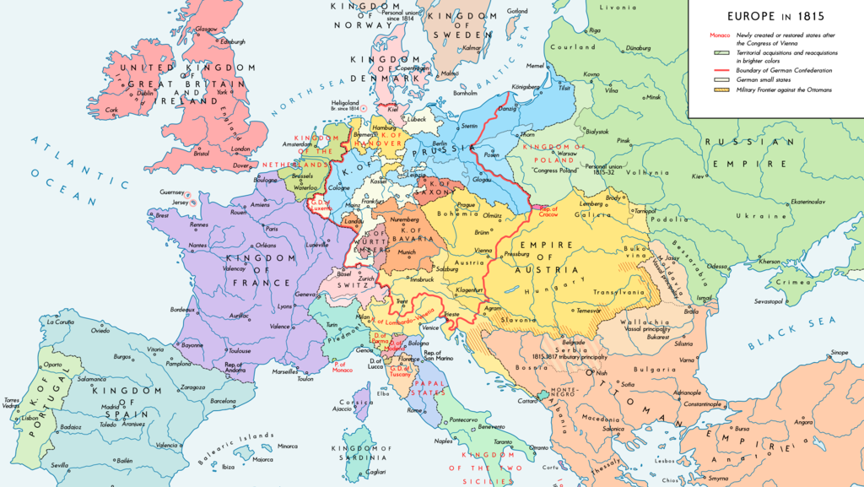

Slide 26
The Creation of Germany
After Napoleon I’s success in defeating the 39 German states, the Rothchild family was able to start a movement to “unify the German-speaking peoples.”
Even when Charlamagne I unified Europe into the Holy Roman Empire, the various nobles over their regions did the actual ruling. The serfs identified more with their nobles than they did with Charlamagne. German history still calls his kingdom the “First Reich.”

Slide 27
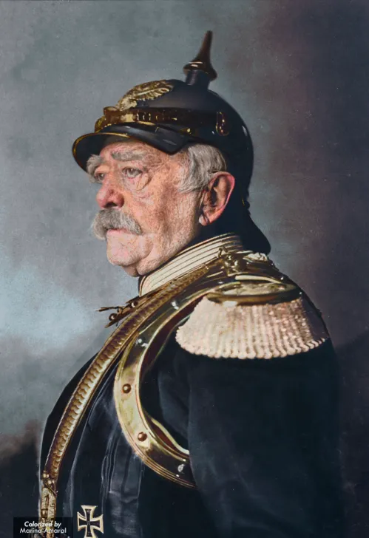
The Creation of the Second Reich
The obvious benefit of unified Germany for the Rothchild banking system was having one central bank instead of over 40, one for each state.
Their opportunity presented itself when Otto von Bismarck was made chancellor of the Prussian Empire in 1862.
After success in the Danish-Prussian War of 1863-1865, the Austro-Prussian War of 1866-1867, and the Franco-Prussian War of 1870, the German state of unified in the German “Second Reich.”

Slide 28
The Creation of the Second Reich
When Germany was “unified,” the Rothchild bankers were quick to establish the German central bank in Frankfurt where it remains today. They set up a banking system that connected Frankfurt, Brussels, Rotterdam, Paris, Milan, and London.
The only link missing was New York City. After the Civil War, the Rothchild family send a young Jacob Schiff to New York to cement a relationship with the American banking system. Later on, they send Paul Warburg as another agent. Both of them hook up with prominent investment banks.

Slide 29
The Banking Issues in the United States
When the United States was formed via the Articles of Confederation, the 13 colonies had their own banks.
With the ratification of the Constitution in 1791, banking was centralized in Congress:
To coin Money, regulate the Value thereof, and of foreign Coin, and fix the Standard of Weights and Measures; (Constitution, §8 ¶6)
To provide for the Punishment of counterfeiting the Securities and current Coin of the United States; (Constitution §8 ¶7)

Slide 30
The Banking Issues in the United States
The United States tried several banking systems in the early part of the 19th century. All of them were failures.
To finance the Civil War, President Lincoln and Congress began issuing paper money, taking a cue from the ancient Chinese banking system. Their “greenbacks” would soon replace the five, ten, and twenty-dollar gold and silver coins.
The Panics of 1896 and 1907 “convinced” Congress to pass the Federal Reserve Act of 1913. Now, the United States had a central bank and before long, it was owned by the Rockefeller Family (representing the Rothchild Family) who controlled J.P. Morgan and other Banking powers in the USA.

Slide 31
The “Federal” Reserve
The Federal Reserve consists of 12 Central Banks throughout the country to manage and control monetary flows.
These 12-member central banks are owned by local banks who own stock in them.
Each of these Member banks is managed by a “governor” who is appointed by the President and confirmed by the Senate. These governors and the chairman govern the Federal Reserve.

Slide 32
The Open Market Committee
The FMOC meets eight times a year to direct all “open market operations” of the Federal Reserve. They set the interest rates.
The Federal Open Market Committee (FOMC) was formed in 1933 to:
Promote Effectively the Goals of Maximum Employment
Stabilize Prices
Moderate Interest Rates

Slide 33
Meanwhile in Europe
Three groupings of people vie for the control of Europe:
The 10 Royal Families
The 13 Illuminati Families
The Bilderberg Group (the World Economic Forum)
The Illuminati Families exert a lot of influence over the Bilderberg Group
The Bilderberg Group serves as a “Board of Directors” for the World Economic Forum.

Slide 34
The Thirteen Illuminati Families
The Astor Bloodline
The Bundy Bloodline
The Collins Bloodline
The DuPont Bloodline
The Freeman Bloodline
The Kennedy Bloodline
The Li Bloodline
The Onassis Bloodline
The Rockefeller Bloodline
The Russell Bloodline
The van Duyn Bloodline
The Merovingian Bloodline
The Rothchild Bloodline

Slide 35
The Ten Royal Families of Europe
The House of Saxe-Coburg-Gotha (Windsor) (Cadet of the Wettin Line)
House of Bourbon (France)
House of Hapsburg (Austria)
House of Bernadotte (Sweden)
House of Orange (The Netherlands, England)
The House of Wettin (Belgium, Poland, et. al.)
The German Royal lines

Slide 36
The Ten Royal Families of Europe
The German Royal Houses – Four Houses – Only One Will Survive?
House of Hohenzollern (Bavaria-Prussia) The Last German Kaisers (kings) were from this house. (Wilhelm I, Wilhelm II)
House of Cronenberg (Germany-Austria)
Two of the Princes and the king in the TV Show Grimm were Cronenbergs though they spelled it Kronenberg. There was one that was either a Windsor or a Hanover prince. (British Accent)
House of Wittelsbach (Northern Germany)
House of Oldenburg (Holstein, Denmark, Norway)
Other German Families of Note:
The House of Hanover (once ruled Great Britain, now extinct)
House of Nassau (now extinct)
House of Wettin (now the House of Saxe-Coberg-Gotha in Great Britain)

